Slide 1


Capstone JDS C6, Group 5
Nazril Daniel Bin Abdullah
Nurhaziqah Binti Mohamad Latif
Siti Adibah Syazwani Binti Mohd Khalid

Slide 2
Objective
Design
Design a predictive model to determine the potential customers who will purchase if you send the advertisement.
Calculate
Calculate the value and the revenue of your model
Compare
Compare your best model's revenue with the revenue of the default solution which is sending advertisement to all the customers in Compare
Assume the next time you want to target a group of 30,000
assume the purchase rate is 10%.
Assume your model will have the same Precision and Recall for Class1
Assume

Slide 3
Methodology
Data Wrangling - Cleaning & Merging: Check and handle the existance of missing values, the type of variables, or integrity of data
Exploratory Data Analysis: Analyze data to summarize their main characteristics
Feature Engineering: Make new features or change the current features
Feature Selection: Choose the best features
Data Pre-Processing: Make data usable for applying ML algorithms.
Model Design: Create several predictive models and tune the hyperparameters
Model Evaluation: Compare the performance of the models
Bonus: Any creative idea for improving machine learning models

Slide 4
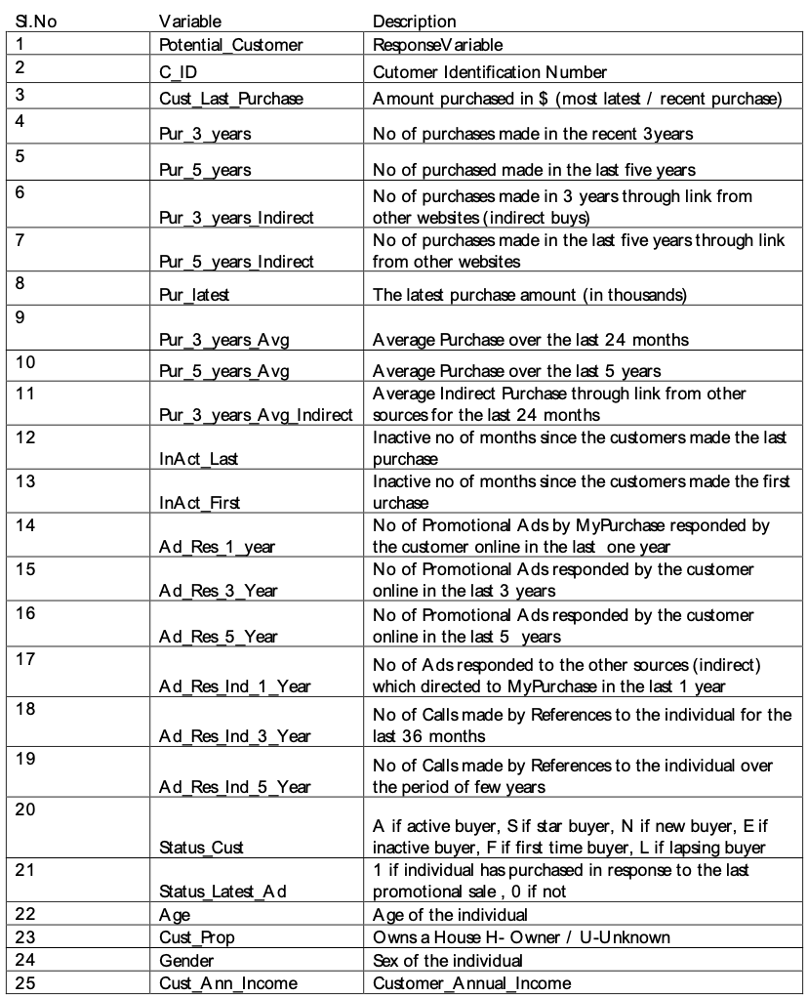
Data Set Description

Slide 5
Data Cleaning & Preparation
Remove the special character from the dataset. ($ , . )
Change data type for object to category and numerical to float64.
Replace Null value of numerical feature to the median of it.
Remove duplicate row.
Adding two high level feature into the dataset.
Check correlation of the feature against target variable.
Drop unrelated feature.

Slide 6
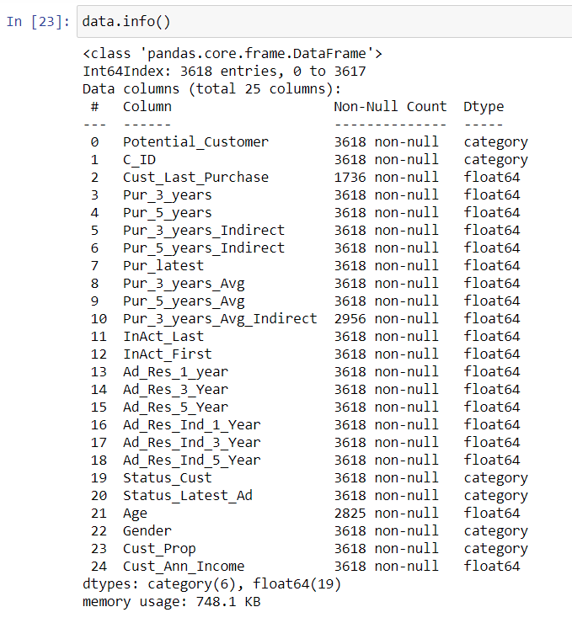
Data Cleansing & Preparation
The final cleaned data frame
Cust_Last_Purchased will be dropped in the next session

Slide 7
Data Insight
Potential Customer There are 48% customers identified as potential buyer based on the features.
Customer Status Highest percentage of customer status is 59.3% which are active meanwhile lowest percentage of customer status are 0.3% which are lapsed buyer and 2.0% are inactive buyers.
Status Advertisement Most of the customers purchase product in response to last promotional sales which made up the 56.9% of the total customers.
Gender This plot shows the distribution of customer gender. The highest gender are female which is about 53.1% and the lowest percentage is 4.6% which is unknown gender.
Customer Property 54.8% of the customers owned a property while 45.2% of the customer identified as unknown. Based on the plot, assumption can be made that most the customers had a residential address.
Age Customer Age It seems like majority of the customer are from older ages ranging from age 40-90 years old (84.5% of total market)

Slide 8
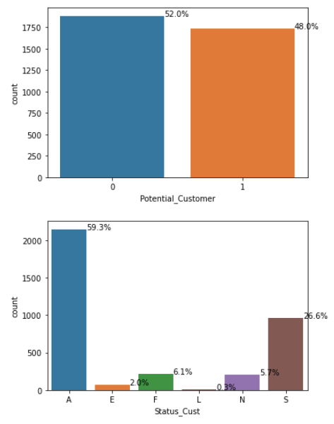
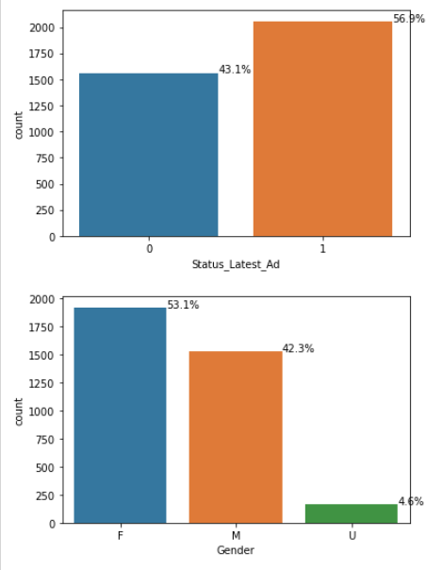

Slide 9
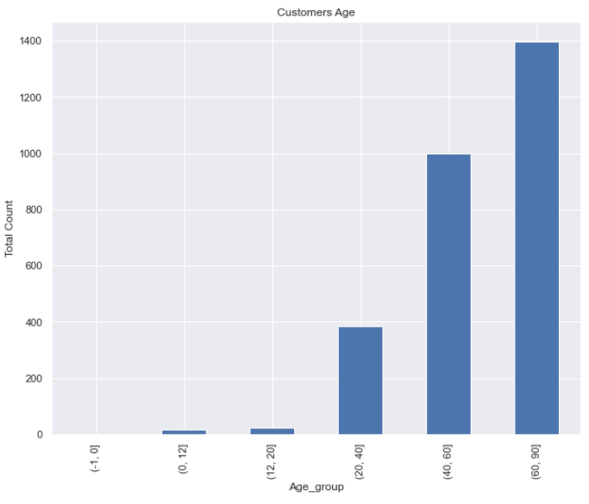
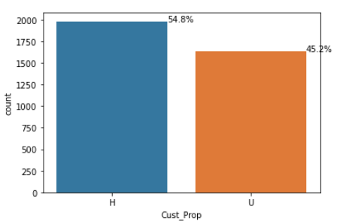

Slide 10
Data Pre-processing
Check for missing values if there is any.
Create predictor variables and target variables.
Create dummy for categorical variables.
Drop customer last purchase feature for analysis purposes.
Split data into train test set. (test_size=0.25, random_state=42, stratify=y).
Perform standard scaling on train and test set.

Slide 11
Machine Learning
Applying Logistic Regression, Decision Tree, K Nearest Neighbor (KNN) and Support Vector Machine (SVM) model on the train set
Using grid search and cross validation to find the best parameter for each model.
Using the best estimator of the model, predict on the test set and generate the confusion matrix.
Generate the precision and recall from the prediction result.

Slide 12
Objective 1
Design a predictive model to determine the potential customer who will purchase if you send the advertisement

Slide 13
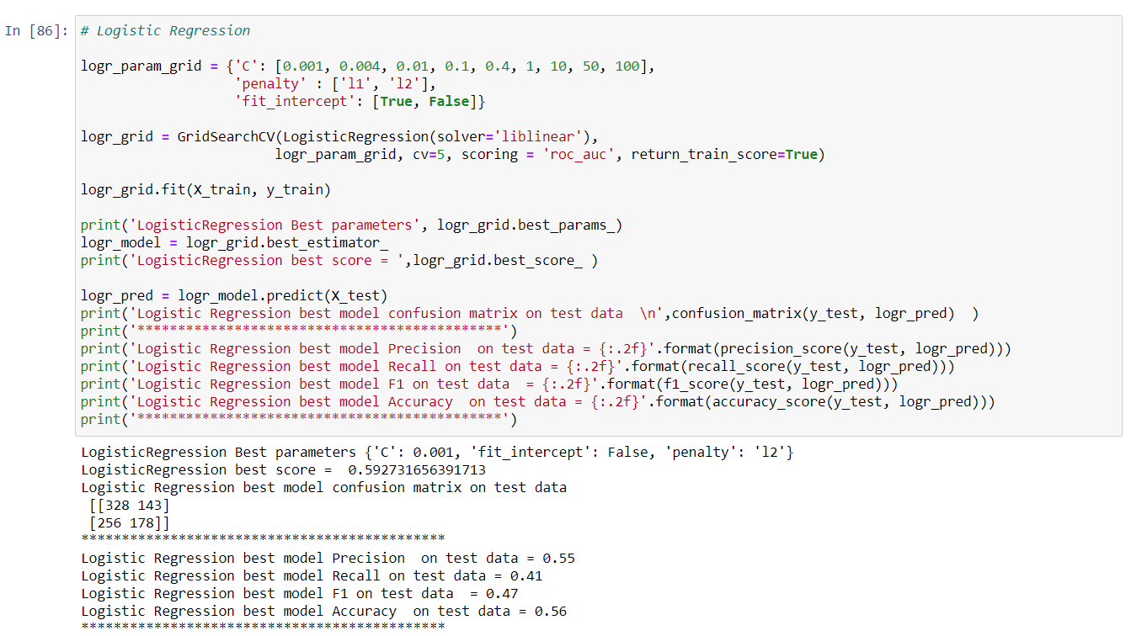
Logistic Regression

Slide 14
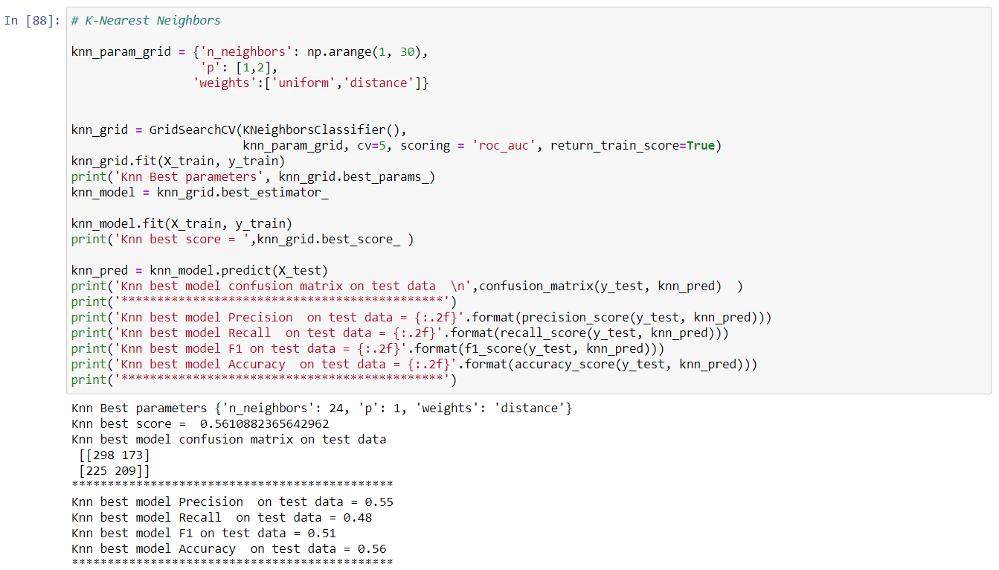
K-Nearest Neighbours (KNN)

Slide 15
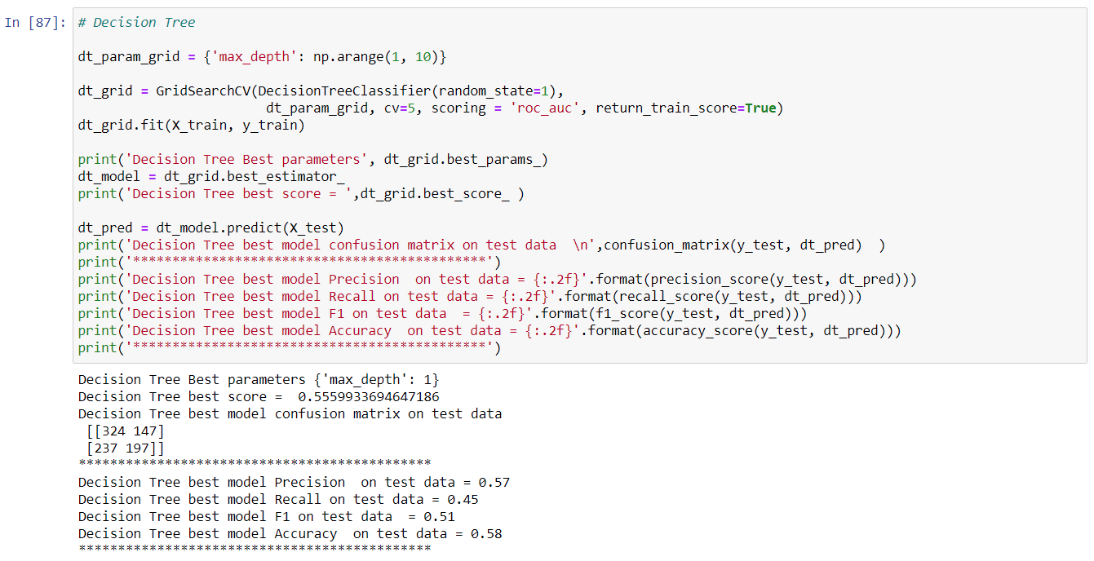
Decision Tree

Slide 16
Support Vector Machine (SVM)

Slide 17
Summary
 | LR | KNN | DT
Precision | 0.55 | 0.55 | 0.57
Recall | 0.41 | 0.48 | 0.45
F1 | 0.47 | 0.51 | 0.51
Accuracy | 0.56 | 0.56 | 0.58

Slide 18
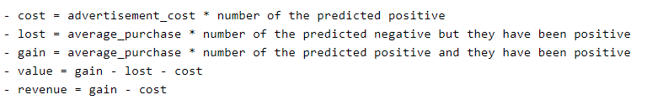
Objective 2
Calculate the value and revenue of the model

Slide 19
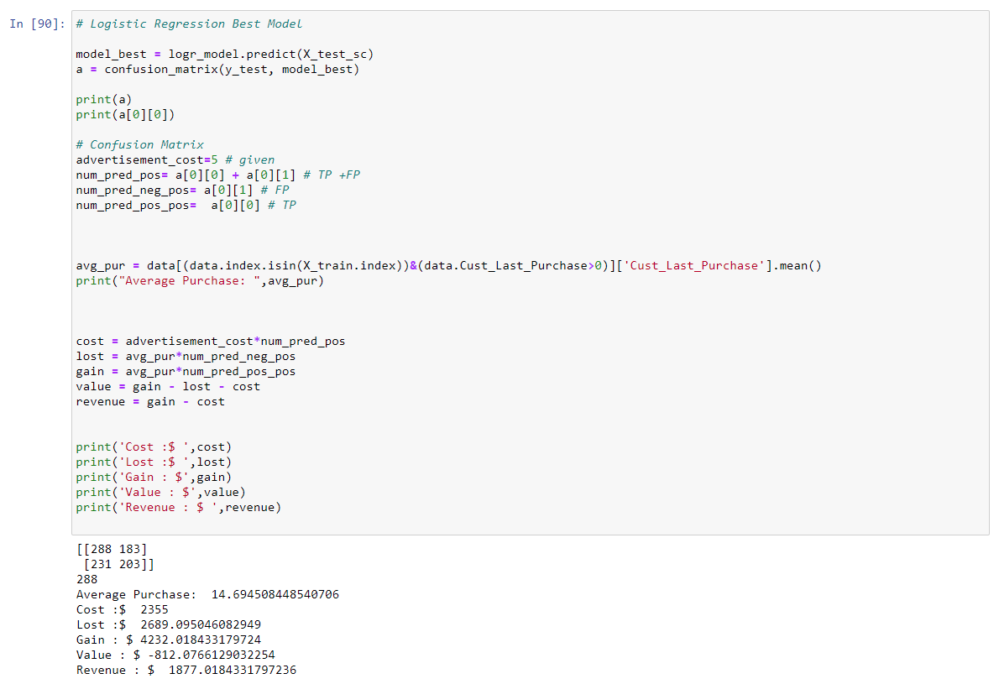
Logistic Regression

Slide 20
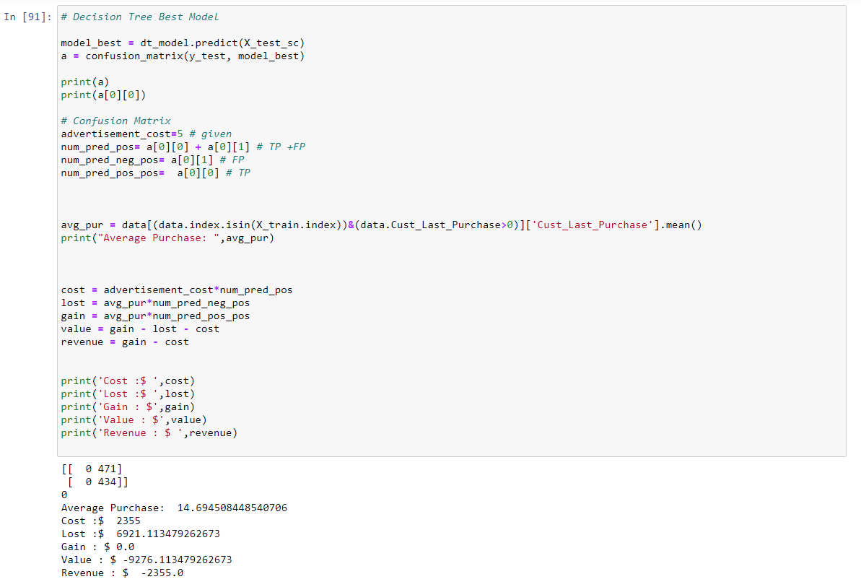
Decision Tree

Slide 21
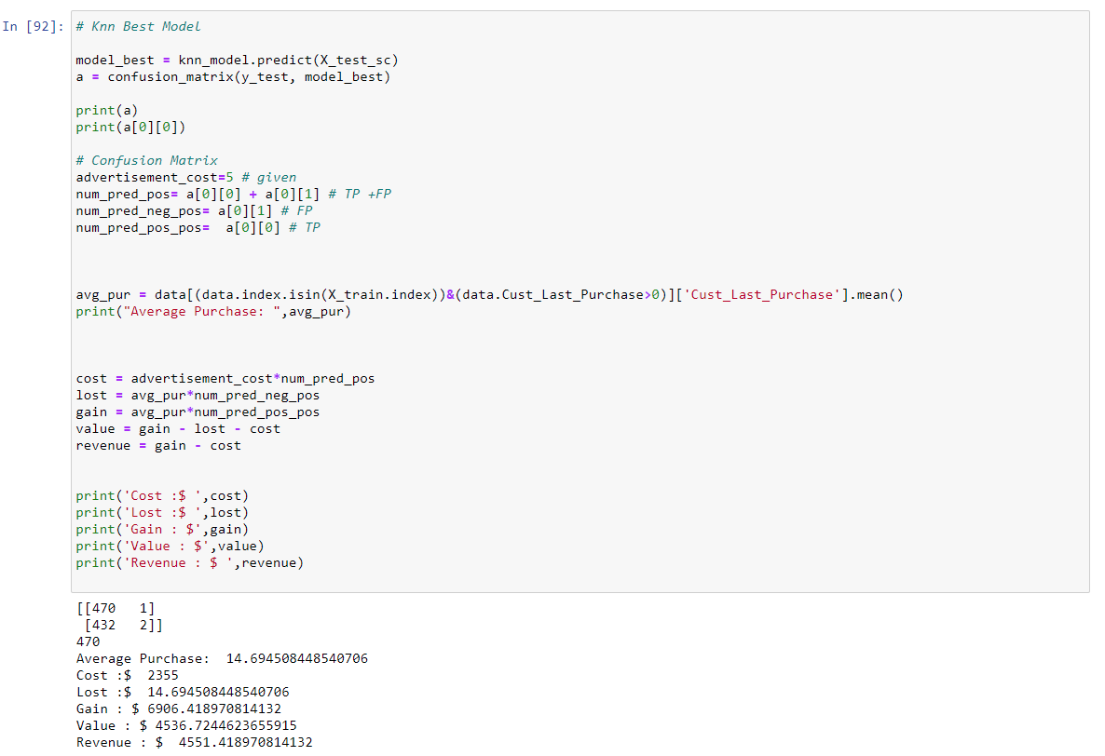
K-Nearest Neighbours (KNN)

Slide 22
Support Vector Machine (SVM)

Slide 23
Summary
 | LR | DT | KNN
Avg Purchase ($) | 14.69 | 14.69 | 14.69
Cost ($) | 2355 | 2355 | 2355
Lost ($) | 2689.10 | 6921.11 | 14.69
Gain ($) | 4232.02 | 0 | 6906.42
Value ($) | -812.08 | -9276.11 | 4536.72
Revenue ($) | 1877.02 | -2355.00 | 4551.42

Slide 24
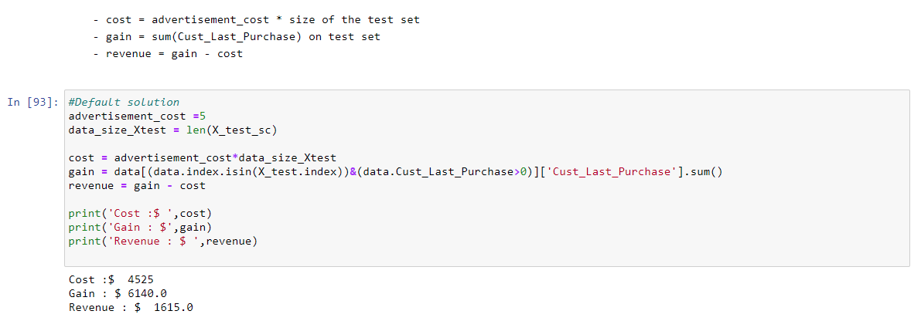
Objective 3
Compare best models’ revenue with the revenue of default solutions

Slide 25
Default Solution

Slide 26
Summary
 | LR | DT | KNN | Default
Avg Purchase ($) | 14.69 | 14.69 | 14.69
Cost ($) | 2355.00 | 2355.00 | 2355.00 | 4525.00
Lost ($) | 3306.26 | 6921.11 | 0.00
Gain ($) | 3614.85 | 0.00 | 6921.11 | 6140.00
Value ($) | -2046.42 | -9276.11 | 4566.11
Revenue ($) | 1259.85 | -2355.00 | 4566.11 | 1615.00
The BEST Model

Slide 27
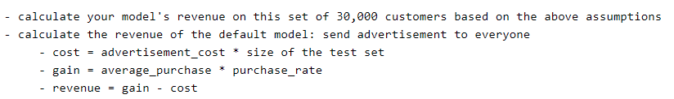
Objective 4
Assumption with target group = 30,000, purchase rate is 10 and having same Precision and Recall

Slide 28
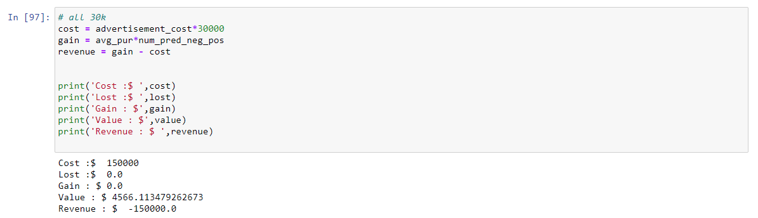
All 30,000

Slide 29
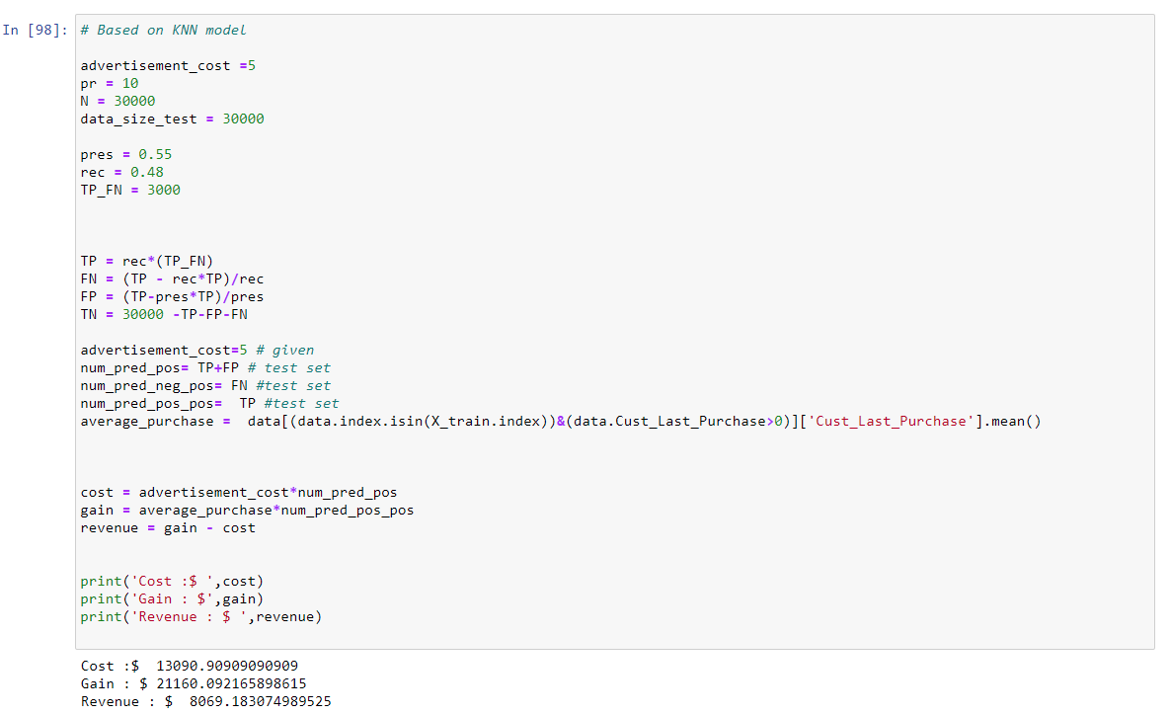
KNN Model

Slide 30
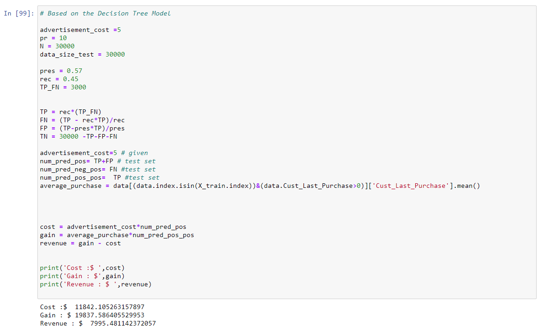
Decision Tree Model

Slide 31
Summary
 | All 30k | KNN | DT
Cost ($) | 150 000.00 | 13 090.91 | 11 842.10
Gain ($) | 0.00 | 21 160.09 | 19 837.59
Revenue ($) | -150 000.00 | 8069.18 | 7995.48

Slide 32
How to improve the model?
1.Use more (high-quality) data and feature engineering
2.Tune the hyperparameters of the algorithm
3.Try different algorithms (Random Forest, SVN)
Random Forests tend to have high accuracy prediction (challenge C2) and can handle large numbers of features (C1) due to the embedded feature selection in the model generation process. Note that when the number of features is large, it is preferable to use a higher number of regression trees.

